Slide 1

Progress Report 2: Desk Stand Up Reminder
Navarro, Rod Geryk C.
CPE160P - 4– A1

Slide 2
OBJECTIVES
To be able to demonstrate and create a stand-up reminder using Arduino R3.
To be able to apply embedded system in reminding the user when to stand-up if the user sits for a long period of time using LCD, and 4- bit seven segment display, as well as the use buttons, ultrasonic sensor and a buzzer.
To be able to effectively remind the user when the time to stand up especially if the user has the habit of sitting for a long period of time or has a work that allows the user to sit for a long time.
To be able to use the skills learned and the functionality of at least five of the seven embedded system and design experiments.

Slide 3
MATERIALS
1x Arduino kit
1x Arduino R3
5x Switch/buttons w/ resistors
1x LCD (16x2)
1x 4-digit seven segment display w/ resistors
2x LEDs w/ resistors
1x Ultrasonic sensor
1x Buzzer w/resistor

Slide 4
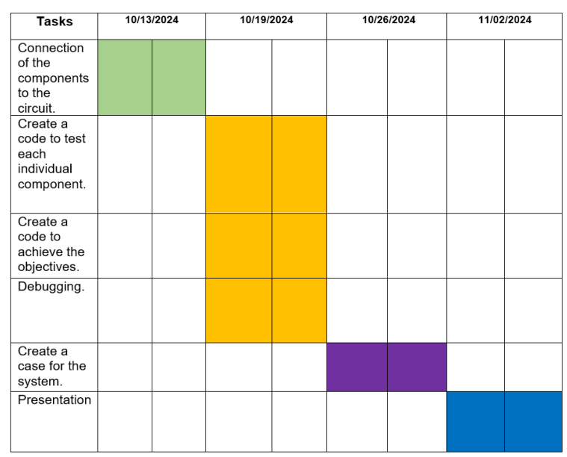
PROCEDURE

Slide 5
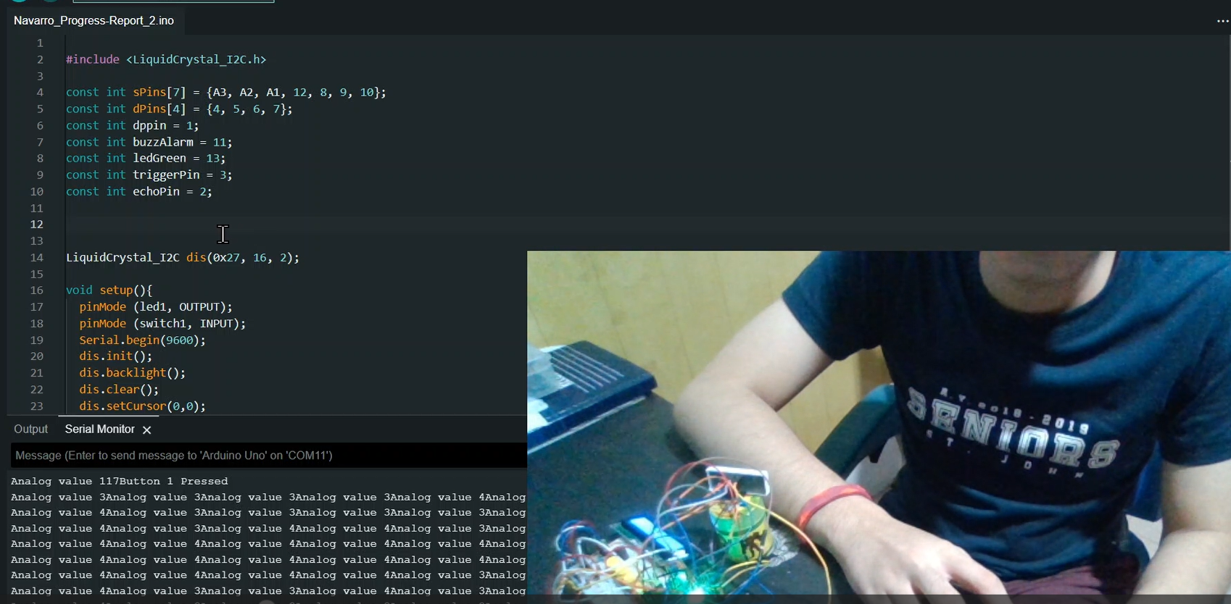
PROCEDURE

Slide 6
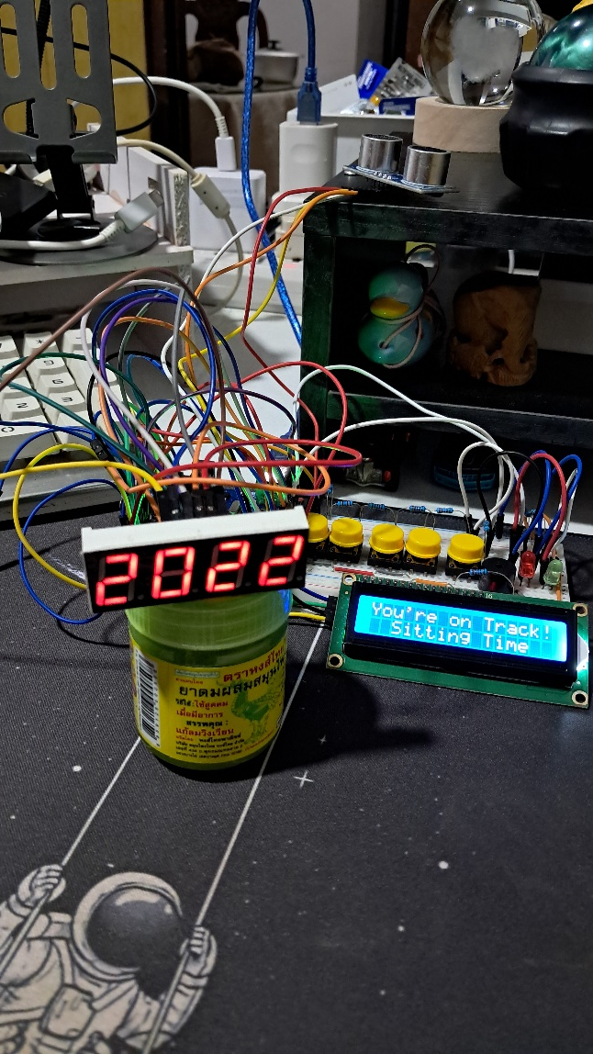
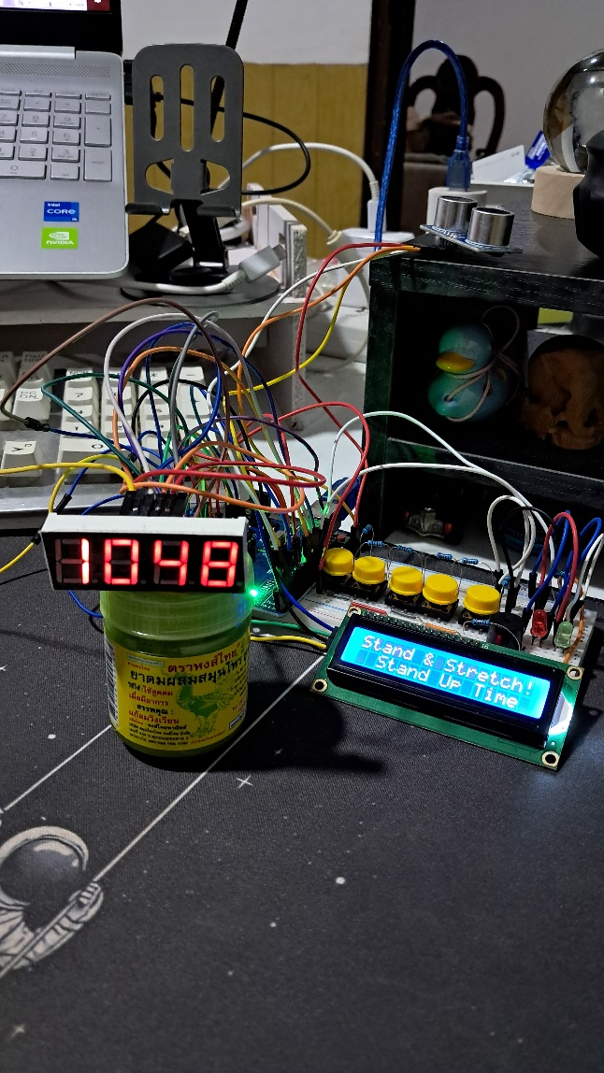
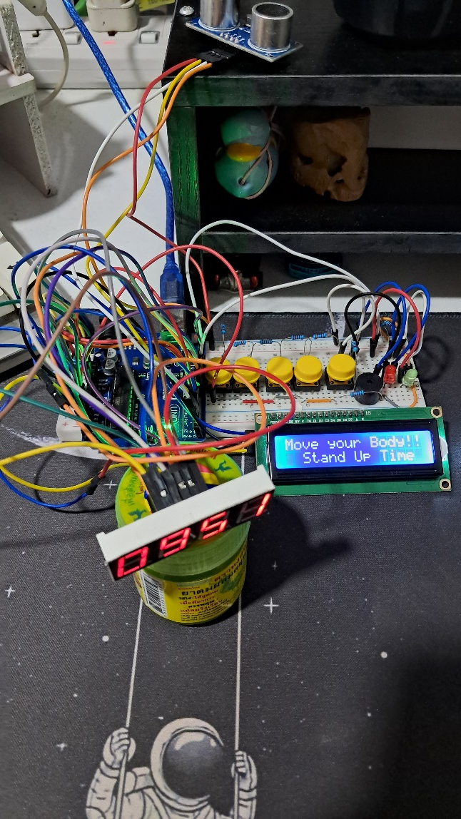
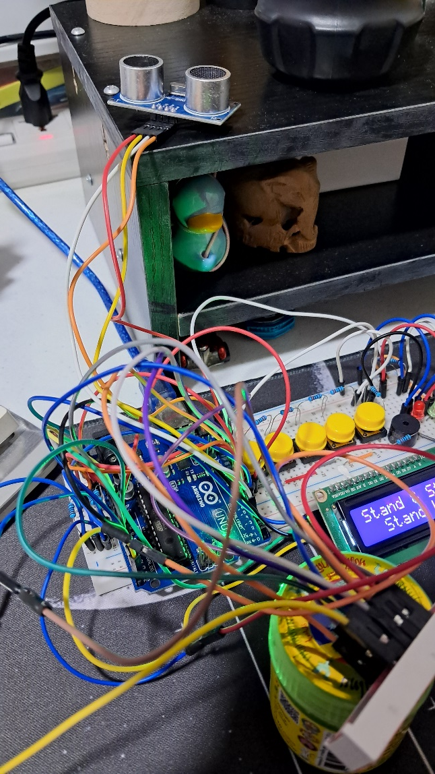
Final Output

Slide 7
THANK YOU!

